Slide 1
Informed Search and Exploration Part I
Instructor: Dr. Wei Ding
Notes:
Slide 25, 10/3

Slide 2
Motivation
Uninformed Search Strategies can find solutions to problems by
Systematically generating new states
Testing them against the goal
Incredibly inefficient in most cases. They will lead away from the goal as easily as it pursues options that lead towards the goal.
Informed Search Strategies
Uses problem-specific knowledge
Can find solutions more efficiently

Slide 3
Heuristic Search Strategies
Informed search tries to reduce the amount of search that must be done by
Making intelligence choices for the nodes that are selected for expansion
This implies the existence of some way of evaluating the likelihood that a given node is on the solution path
In general this is done using a heuristic function
heu·ris·tic: enabling a person to discover or learn something for themselves.

Slide 4
Best-First Search
Idea: use an evaluation function f(n) for each node
Estimate of “desirability”
Expand most desirable unexpanded node
Traditionally, the node with the lowest evaluation is selected for expansion, because the evaluation measures distance to the goal.
Implementation
Order the nodes in fringe in decreasing order of desirability
The name “best-first search” is a venerable but inaccurate one, why?
Notes:
After all, if we could really expand the best node first, it would not be a search at all; it would be a straight march to the goal

Slide 5
“Seemingly-Best-First Search”
All we can do is choose the node that appears to be the best according to the evaluation function
If the evaluation function is exactly accurate, then this will indeed be the best node
In reality, the evaluation function will sometimes be off, and can lead the search astray

Slide 6
Best-first-Search Algorithms with Different Evaluation Functions
Breadth-first search is a best-first search with
f(n)=depth(n)
Depth-first search is best-first search with
f(n)=-depth(n)
A key component of best-first-search algorithms is a heuristic function, denoted
h(n)=estimated cost of the cheapest path from node n to a goal node
A heuristic function h(n) takes a node as input, but it depends only on the state at that node.

Slide 7
Example: Romania with step costs in km

Slide 8
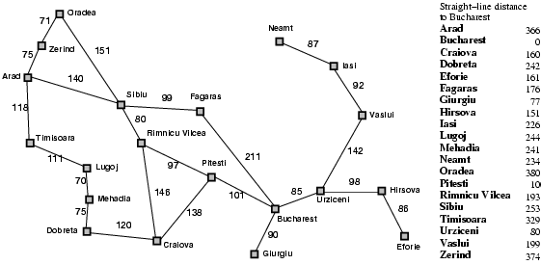
Example: Romania with step costs in km
In Romania, one might estimate the cost of the cheapest path from Arad to Bucharest via the straight-line distance from Arad to Bucharest.
In n is a goal node, then h(n)=0

Slide 9
Greedy Best-First Search
Greedy best-first search tries to expand the node that is closest to the goal, on the grounds that this is likely to lead to a solution quickly.
Evaluation function f(n)=h(n) (heuristic) = estimate of cost from n to goal
For example, h_{SLD}(n)=straight-line distance from n to Bucharest

Slide 10
Greedy Algorithm
A greedy algorithm follows the “eat dessert first, since you never know if you will get to finish your meal” mantra. That is, we make the best local decisions without worrying about the future (or what Mom will say if you eat dessert before finishing your broccoli).
Greedy best-first search expands the node that appears to be closest to goal

Slide 11
Greedy Best-First Search Example
h_{SLD}(n)=straight-line distance from n to Bucharest
The values of h_{SLD} cannot be computed from the problem description itself
It takes a certain amount of experience to know that h_{SLD} is correlated with actual road distances and is, therefore, a useful heuristic

Slide 12

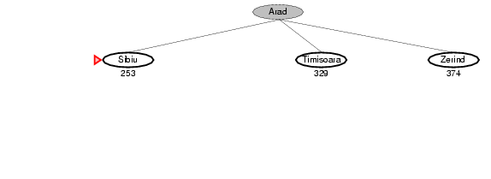
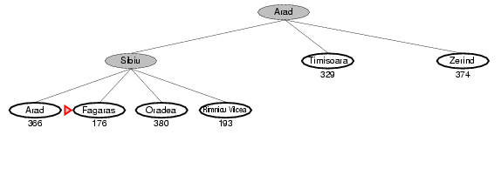
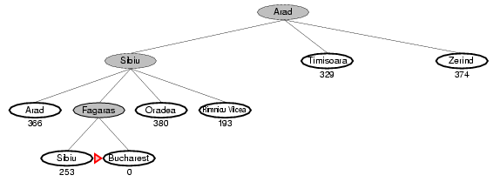
Greedy Best-First Search Example
(a) The initial state
(b) After expanding Arad
(c) After expanding Sibiu
(d) After expanding Fagaras
Notes:
This shows why the algorithm is called greedy – at each step it tries to get as close to the goal as it can

Slide 13
Greedy Best-First Search Example
(a) The initial state
(b) After expanding Arad
260
(c) After expanding Sibiu
260
270
271
If in another example, the h function has different values for Zerind, Fagaras, Rimnicu Vilcea, then Zerind should be the next state to be expanded
Notes:
This shows why the algorithm is called greedy – at each step it tries to get as close to the goal as it can

Slide 14
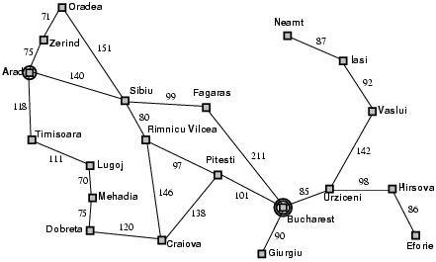
Properties of Greedy Best-First Search
Complete? No, it can get stuck in loops.
For example, consider the problem of getting from Iasi to fagaras. Iasi→Neamt→Iasi→Neamt…

Slide 15
Properties of Greedy Best-First Search
Time? The worst-case time complexity is O(b^{m}), where m is the maximum depth of the search space, b is the branching factor or maximum number of successors of any node.
Space? The worst-case space complexity is O(b^{m}). It has to keep all the nodes along the path in memory before it hits a dead end or approaches the goal state.
Notes:
Check out the complexity of time about O(b^m)

Slide 16
Properties of Greedy Best-First Search
Optimal? No.
Greedy best-first search resembles depth-first search in the way it prefers to follow a single path all the way to the goal, but will back up when it hits a dead hit.
The algorithm suffers from the same defects as depth-first search – it is not optimal, and it is incomplete.

Slide 17
A* search
Pronounced “A-star search”
Idea: avoid expanding paths that are already expensive.
Evaluation function f(n)=g(n)+h(n)
function g(n), the path cost to reach the node (we can get an exact value of it)
h(n), the heuristic function to estimate the cost to get from the node n to the goal
f(n) is the estimated total cost (cheapest solution) of path through n to goal

Slide 18
Strategy
To find the cheapest solution, a reasonable thing to try first is the node with the lowest value of g(n) + h(n)
Provided that the heuristic function h(n) satisfies certain conditions, A* search is both complete and optimal.
If used with tree-search, A* is optimal if h(n) is …

Slide 19
Admissible Heuristics
A heuristic h(n) is admissible if for every node n, h(n) ≤ h*(n), where h*(n) is the true cost to reach the goal state from n.
An admissible heuristic never overestimates the cost to reach the goal
Admissible heuristic are by nature optimistic, because they think the cost of solving the problem is less than it actually is.
Hence …

Slide 20
Admissible Heuristics
Since g(n) is the exact cost to reach n, we have immediate consequence that f(n) never overestimates the true cost of a solution through n.
Theorem: if h(n) is admissible, A* using Tree-Search is optimal.

Slide 21

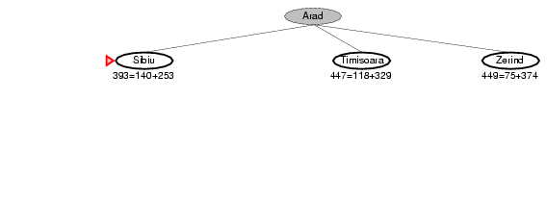
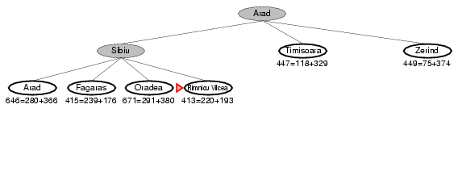
A* Search Example
(a) The initial state
(b) After expanding Arad
(c) After expanding Sibiu
Nodes are labeled with f=g+h. The h values are the straight-line distances to Bucharest

Slide 22
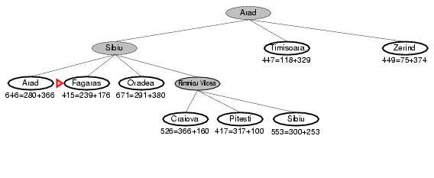
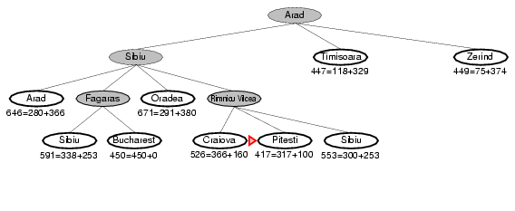
A* Search Example
(d) After expanding Rimnicu Vilcea
(e) After expanding Fagaras

Slide 23
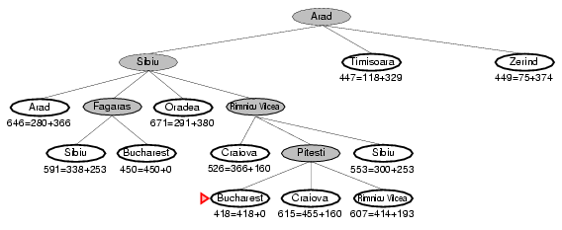
A* Search Example
(f) After expanding Pitesti

Slide 24
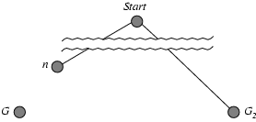
Optimality of A* (proof)
Suppose some suboptimal goal G₂ has been generated and is in the fringe. Let n be an unexpanded node in the fringe such that n is on a shortest path to an optimal goal G. Let C* is the cost of optimal solution. Will G₂ be expanded (incorrect)?
f(G₂) = g(G₂) since h(G₂) = 0,
g(G₂) > g(G) since G₂ is suboptimal
f(G) = g(G) since h(G) = 0
f(G₂) > f(G) from above
f(n) = g(n) + h(n) ≤ C*, since h is admissible
f(n) ≤ f(G)< f(G₂) from above
So G₂ will not be expanded and A* must return an optimal solutions

Slide 25
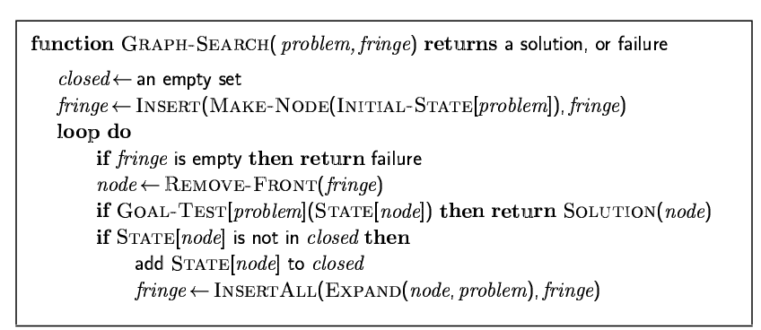
Revisit “Closed List”
Graph-Search modifies the general tree-search algorithm to include a data structure called the closed list, which stores every expanded node.
If the current node matches a node on the closed list, it is discarded instead of being expanded.
What does a repeated state mean?

Slide 26
Repeated State
When a repeated state is detected, the algorithm has found two paths to the same state.
The graph-search algorithm always discards the newly discovered path
However, if the newly discovered path is shorter than the original one, graph-search could miss an optimal solution.

Slide 27
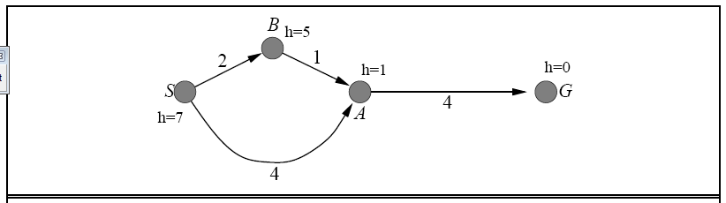
Example
A graph with an inconsistent heuristic on which graph-search fails to return the optimal solution
The successors of S are A with f=5 and B with f=7. A is expanded first, so the path via B will be discarded because A will already be in the closed list. However, the optimal solution is S→B→A→G.

Slide 28
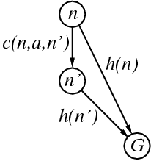
Consistent Heuristics
A heuristic is consistent if for every node n, every successor n' of n generated by any action a,
h(n) ≤ c(n,a,n') + h(n')
The estimated cost of reach the goal from n is no greater than the step cost of getting to n’ plus the estimated cost of reaching the goal from n’
This is a form of Triangle inequality

Slide 29
Consequence of Consistency
A* using graph-search is optimal if h(n) is consistent
Consistency is a stricter requirement than admissibility
But one has to work quite hard to concoct heuristics that are admissible but not consistent
All the admissible heuristics we discuss in this chapter are also consistent
For example, h_{SLD}. We know that the general triangle inequality is satisfied when each side is measured by the straight-line distance, and the straight-line distance between n and n’ is no greater than c(n,a,n’). Hence, h_{SLD} is a consistent heuristic.

Slide 30
Consequence of Consistency
If h(n) is consistent, then the values of f(n) along any path are non-decreasing.
Proof: Suppose n’ is a successor of n; then g(n’)=g(n)+c(n,a,n’) for some action a, and we have
f(n’)=g(n’)+h(n’)= g(n)+c(n,a,n’)+h(n’)>=g(n)+h(n)=f(n)
Hence the first goal node selected for expansion must be an optimal solution, since all later nodes will be at least as expensive.

Slide 31
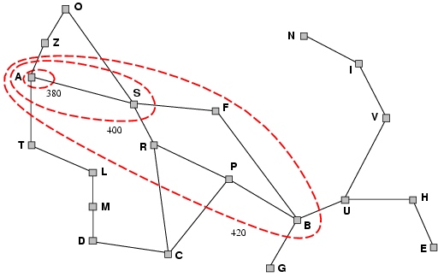
Contours
A* expands nodes in order of increasing f value
Gradually adds "f-contours" of nodes
Contour i has all nodes with f=f_{i}, where f_{i} < f_{i+1}

Slide 32
Properties of A*
Complete? Yes, unless there are infinitely many nodes with f<=f(G)
Optimal? Yes.
Time? Exponential
Space? Keeps all nodes in memory

Slide 33
Optimally Efficient
No other optimal algorithm is guaranteed to expand fewer nodes than A*, except possibly through tie-breaking among nodes with f(n)=C*, where C* is the cost of the optimal solution.
That A* search is complete, optimal, and optimally efficient among all such algorithms is rather satisfying.
However, A* is not the answer to all our searching needs. Why?
To be continued …

